Slide 1
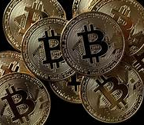
Hedging Bits
2020 Impact on Investments
Chelsea Senter
Ryan Lassiter
Darren Raymond
Emisael Lopez
Meredith Johnson

Slide 2
Agenda
Project Background & Hypothesis
Data Exploration, Cleaning & Merging
Data Analysis & Visualizations on three key events
Covid-19
Social Unrest / George Floyd
Election Weeks
Discussion & General Conclusions
Questions

Slide 3
Project Background & Hypothesis
Hypothesis
If bitcoin functions like a gold investment, then uncertainty experienced with Covid-19, Social Unrest (anchored by George Floyd) and the US Election will cause investors to leave the market (Dow) and invest in bitcoin and gold
Questions
Did bitcoin yield a higher return than the Dow over 2020?
Summary
With Covid-19 and the George Floyd protests, bitcoin and gold paralleled each other in trend, but as the election neared, bitcoin sharply rose while gold declined
Is bitcoin favored during US economic downturn (GDP benchmarkers)?
How did bitcoin perform over Gold during the Pandemic as a safeguard alternative investment?
Did investors hedge with bitcoin during the Covid-19 pandemic?

Slide 4



Data Exploration
Bitcoin data source (api)
Dow data source (csv)
Gold data source (csv)
url = 'https://api.coindesk.com/v1/bpi/historical/
2020 Key Events | Dates | Orientation
Covid-19 | 02-28-2020 – 03-26-2020 | Worldwide
Social Unrest/ George Floyd | 05-25-2020 – 06-25-2020 | US
US Election | 11-02-2020 – 11-14-2020 | US
https://fred.stlouisfed.org/series/DJIA;
https://www.nasdaq.com/market-activity/commodities/gc%3Acmx/historical

Slide 5
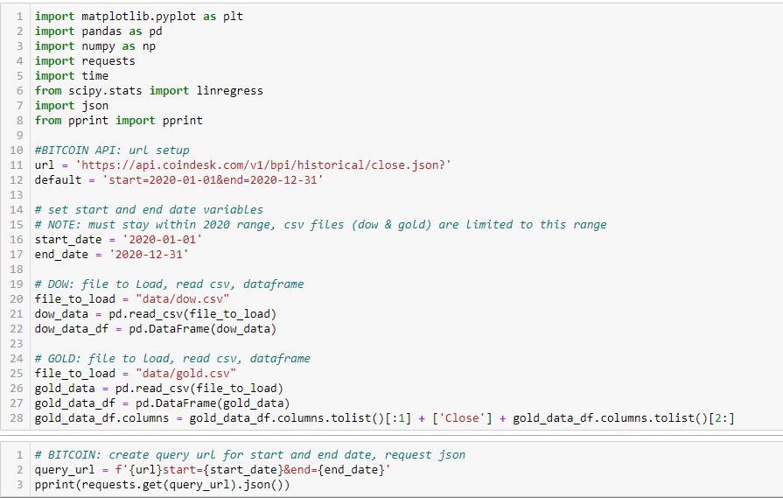
Data Sourcing
Sourcing

Slide 6
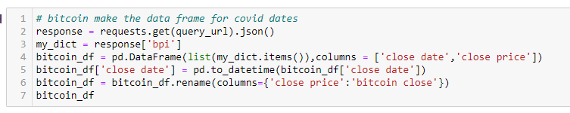
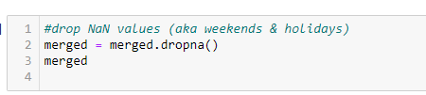
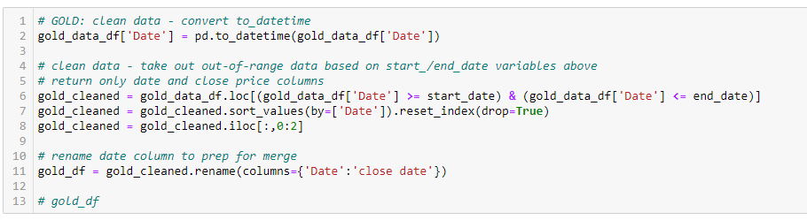
Data Cleaning
Reading as object rather than datetime
Column Headers with “/”
Weekend Dates

Slide 7
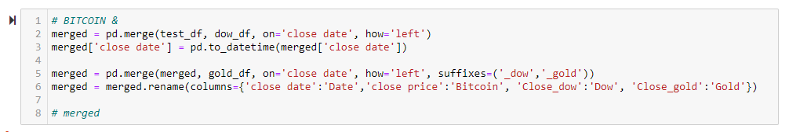
Data Merging
Merge api and dow
Merge combined to gold

Slide 8
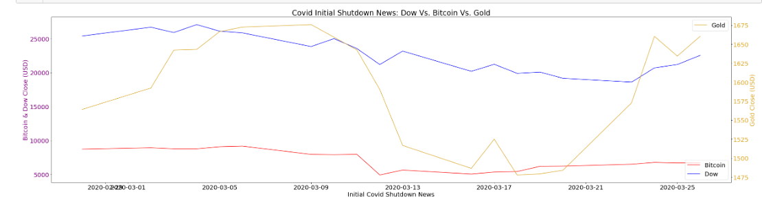
Data Analysis & Visualizations: Covid-19 Impact
Gold: Panic Selling & Resulting Recovery with Gold
Dow: Experienced Panic Selling on news of COVID-19 and resulting impact to business; recovery lagged gold
Bitcoin: Dipped and then experienced a modest recovery

Slide 9
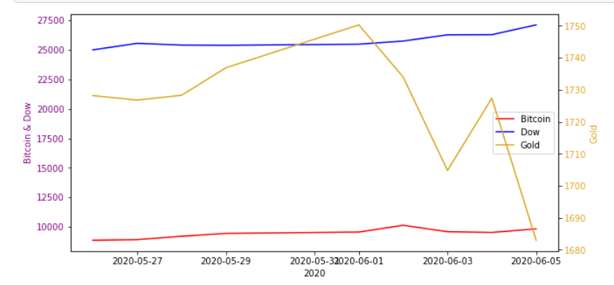
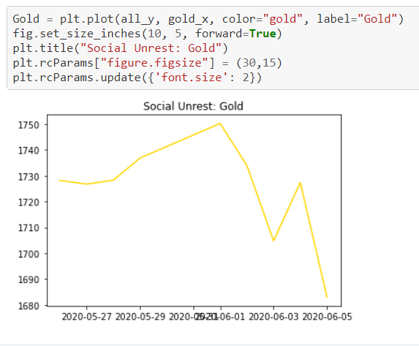
Data Analysis & Visualizations: George Floyd/Social Unrest Impact
George Floyd/Social Unrest Impact
No significant impact observed from Dow and Bitcoin from our dates selected
Gold declined somewhat during the period after Memorial Day and the beginning of social unrest protests

Slide 10
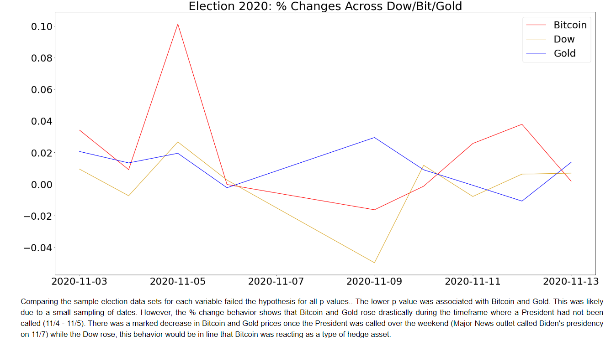
Data Analysis & Visualizations: % Change – US Election Cycle Impact
Comparing the sample election data sets for each variable through ANOVA testing failed the hypothesis for Bitcoin and Gold & Bitcoin and Dow.
The lowest p-value was associated with Bitcoin and Gold (P-value = .135) Failure was likely due to a small sampling of dates.
However, the % change behavior shows that Bitcoin and Gold rose drastically during the timeframe of election outcome uncertainty (11/4 - 11/5).
There was a marked decrease in Bitcoin and Gold prices once the President was called over the weekend (Major News outlet called Biden's presidency on 11/7) while the Dow rose.
This behavior would be in line that Bitcoin was reacting as a type of hedge asset.

Slide 11
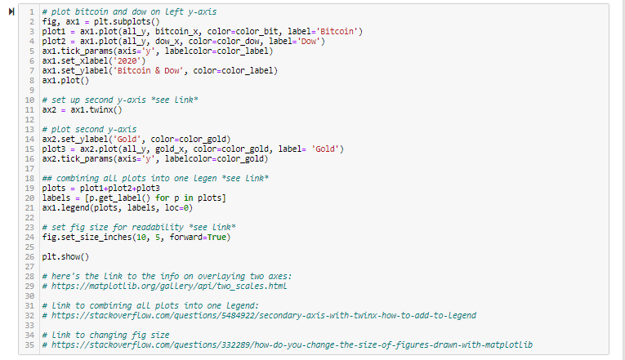
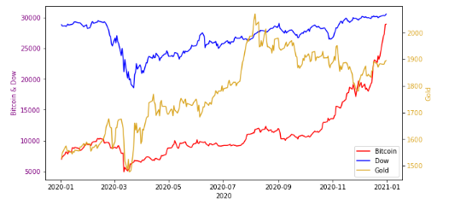
Data Analysis & Visualizations: Line Graph
Covid-19 Impact
George Floyd/Social Unrest Impact
US Presidential Election Impact
All indices dipped
No significant impact observed from our dates selected
Bitcoin and Gold experienced a steep rise approaching election; the Dow took a slight dip but recovered

Slide 12
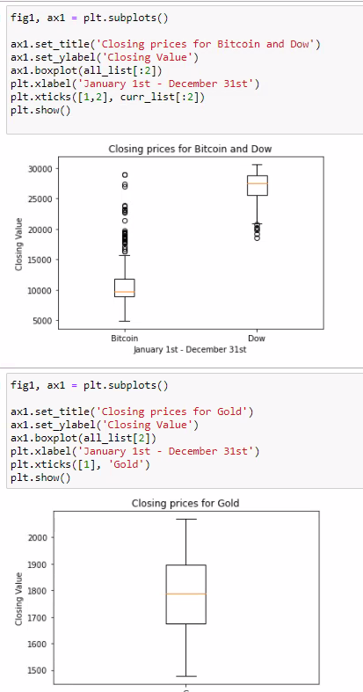
Data Analysis & Visualizations: 2020 Indices Box Plots
Throughout 2020, Bitcoin and Dow had more outliers and greater variability than Gold

Slide 13
Discussion & Conclusion
Inferences & Issues:
Immediate standard error with subjectivity on selected dates analyzed
Point –of -View is from the United States
Investor community may be insulated to social injustice
Bitcoin is still in infancy relative to the Dow and Gold; should expect it to experience greater volatility
Additional data analyses exploration within Juptyer notebook
Conclusion:
Hypothesis: If bitcoin functions like a gold investment, then uncertainty experienced with Covid-19, Social Unrest (anchored by George Floyd) and the US Election will cause investors to leave the market (Dow) and invest in bitcoin and gold.
Our analysis and findings indicate that Bitcoin experiences quicker reactions to news making events but recovers more quickly and favorably as it is gains mainstream status. This is indicated on the line graphs, the box plots. The ANOVA test proved that Bitcoin investors use Bitcoin a lot like Gold – as a hedge asset; indicating investor comfort level with Bitcoin as an investment.

Slide 14
Thank you!
Questions?

